Slide 1
CLASSES & OBJECTS

Slide 2
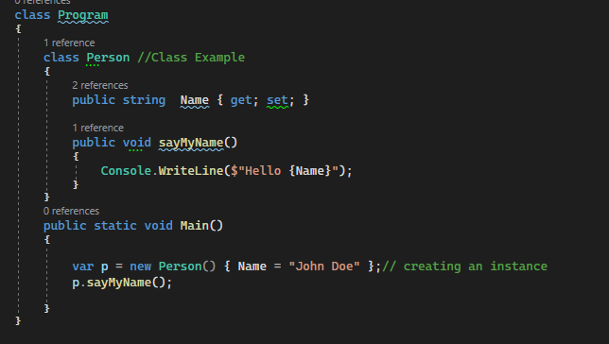

Classes and Objects
Class:
A class is simply a user-defined data type that represents both state and behavior. The state represents the properties and behavior is the action that objects can perform. In other words, we can say that a class is the blueprint/plan/template that describes the details of an object. A class is a blueprint from which the individual objects are created. In C#, a Class is composed of three things i.e. a name, attributes, and operations.
Objects:
It is an instance of a class. A class is brought live by creating objects. An object can be considered as a thing that can perform activities. The set of activities that the object performs defines the object’s behavior. All the members of a class can be accessed through the object. To access the class members, we need to use the dot (.) operator. The dot operator links the name of an object with the name of a member of a class

Slide 3
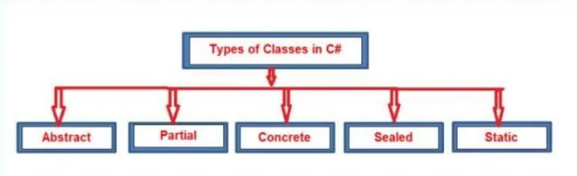
As you can see in the above image, here we have one class called “Employee”. All the Employees have some properties such as employee id, name, salary, gender, department, etc. These properties are nothing but the attributes (properties or fields) of the Employee class.
If required you can also add some methods (functions) that are common to all Employees such as InsertData and DisplayData to insert and display the Employee Data.
So, the idea is that the template or blueprint of the Employee is not going to change. Each and every Object is going to build from the same template (Class) and therefore contains the same set of methods and properties

Slide 4
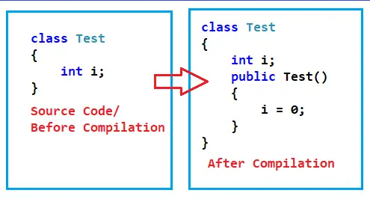
What is a Constructor
It is a special method present inside a class responsible for initializing the variables of that class.
The name of the constructor method is exactly the same name as the class in which it was present. You cannot change the name. If your class name is Employee, then the name of the constructor method is going to be Employee, and if your class name is Student, then the constrictor name is also going to be Student.
The constructor method does not return any value. That means it is a non-value returning method. Generally, methods are of two types i.e. value returning and non-value returning and constructors are purely non-value returning. That is, they never return any value.
Each and every class requires this constructor if we want to create the instance of the class. If we don’t have a constructor, then we cannot create an instance of the class. At this point, you have one doubt, earlier we defined many classes but we never used a constructor, but still, we are able to create the instance of the class, how? Let us clarify this doubt.
The Constructors are responsible for two things. One is the object initialization and the other one is memory allocation. The role of the new keyword is to create the object and the role of the constructor is to initialize the variables.

Slide 5
The reason is that it is the responsibility of a programmer to define a constructor under his class and if he/she fails to do, on behalf of the programmer an implicit constructor gets defined in that class by the compiler. For a better understanding, please have a look at the below diagram which shows the code before and after compilation.
Every variable we declared inside a class and every field we declared inside a class has a default value. All numeric types are initialized with 0, Boolean types initialized with false, and string and object types initialized with null.
Like this, the initialization is performed for each and all variables present in the class and this is the responsibility of the constructor. That is why a constructor is very important for us inside a class.
The constructor defined by the compiler is known as an Implicit Constructor. And if we defined the same thing, then it is called an explicit constructor.

Slide 6
Points to Remember while working with Constructors
Implicitly Defined Constructors are parameter less and these constructors are also known as Default Constructors. This is because they are used to initialize the variables with default values.
Implicitly Defined Constructors are public. If you see in our example, we define the class Test with a default access specifier but the constructor is public which is generated by the compiler.
We can also define a constructor under the class and if we define it, we can call it an Explicit Constructor and an Explicit Constructor can be parameter less and parameterized also.

Slide 7
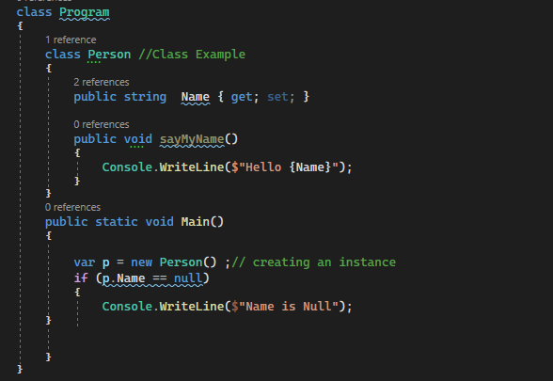

Implicit Constructors

Slide 8
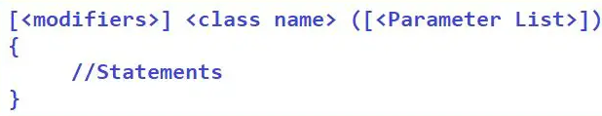
How to Define the Constructor Explicitly
We can also define the constructor explicitly in C#. The following is the explicit constructor syntax.

Slide 9
Defining and Calling Constructor
Defining: Defining a constructor means implementing a constructor in your class. Defining can be two types i.e. Implicit and Explicit. Implicit means the compiler will define the constructor. Explicit means we as a programmer define the constructor. The following code shows defining a constructor explicitly.
Calling: Whenever we are creating the instance, we are calling the constructor. Calling is Explicit. We should only call. There is no implicit call to the constructor. For a better understanding, please have a look at the below code.

Slide 10
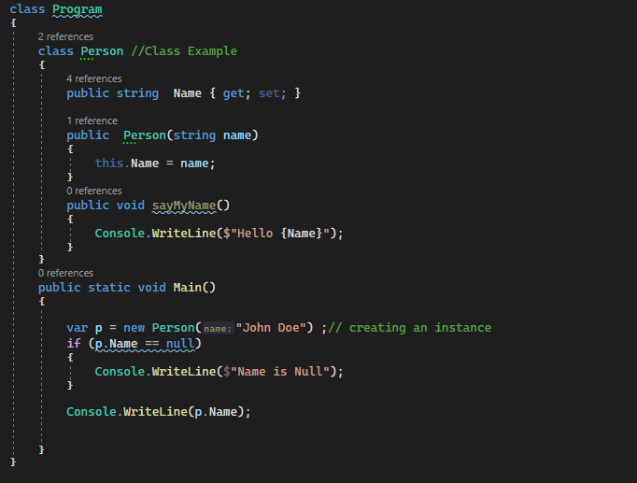

Explicit Constructors

Slide 11
Static vs Non-Static Constructors
If a constructor is explicitly declared by using the static modifier, we call that constructor a static constructor whereas the rest of the others are called non-static constructors only.
Constructors are responsible for initializing the fields or variables of a class. Static Fields/Variables are initialized by static constructors and non-static fields/variables are initialized by non-static or instance constructors in C#
Static constructors are implicitly called whereas non-static constructors are explicitly called.
Static Constructors execute immediately once the execution of a class start and moreover, it is the first block of code to run under a class whereas non-static constructors execute only after creating the instance of the class as well as each and every time the instance of the class is created.
Static Constructors are executed only once whereas the non-static constructors are executed 0 or n number of times depending on the number of instances we created for the class
Non-Static Constructors can be parameterized whereas the static constructors cannot have any parameter. This is because we explicitly call the non-static constructors, so we can have a chance to pass parameters. On the other hand, static constructors are implicitly called and it is the first block of code to run under a class, and hence we don’t have any chance to pass parameters.

Slide 12
Non-Static Constructors can be overloaded whereas static constructors cannot be overloaded. Overloading is something that comes into the picture based on the parameters. As we have a chance to pass parameters in the case of non-static constructors, overloading is possible. On the other hand, we cannot pass parameters to static constructors i.e. static constructors are parameterless, and hence overloading is not possible.
Every class contains an implicit constructor if not defined explicitly and those implicit constructors are defined based on the following criteria.
Every class except a static class contains an implicit non-static constructor if not defined with an explicit constructor.
Static constructors are implicitly defined only if that class contains any static fields or else that constructor will not be present provided that the class does not have an explicit static constructor.

